Slide 1
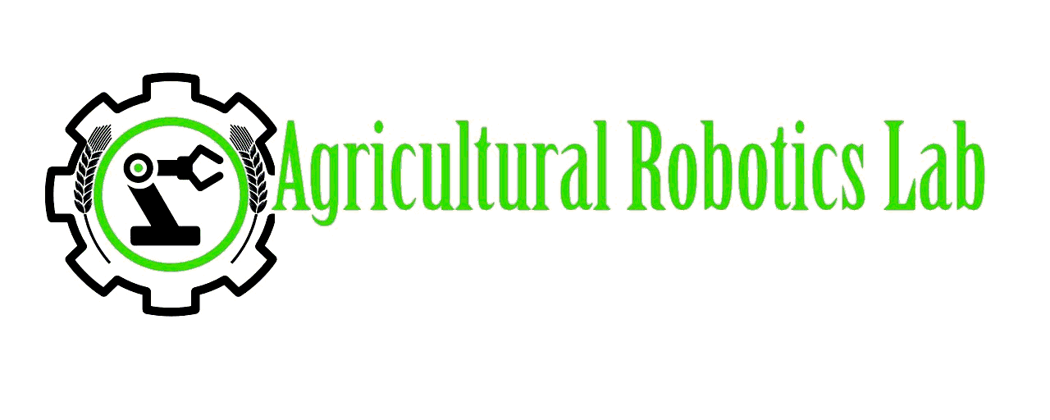
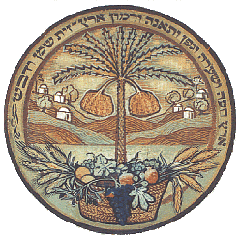

Development of a Robotic Inspection System for Early Detection and Locating of Biotic and Abiotic Stresses in Greenhouse Crops
T. Mhabary^{1,4}, A. Ozeri¹ , A. Moshaiov⁴, S.Y. Nof², Y. Tao³ and A. Bechar^{1,5}
1 - Institute of Agricultural Engineering, Agricultural Research Organization (ARO), Volcani Center, Israel
2- PRISM Center and School of Industrial Engineering, Purdue University, USA
3- Fischell Department of Bioengineering, University Of Maryland, USA
4- School of Mechanical Engineering, Tel-Aviv University
5- Department of Industrial Engineering and Management, Ben Gurion University of the Negev
Notes:
thank you chairman, my name is Tamir Mhabary, Research Eng. At Volcani center and master student in TAU.
I am going to present one of our projects: “”

Slide 2
Problems Definition
Late detection → spreading of stresses →irreparable damage
Overdose use of nutrients, pesticides and fertilizers
Manual monitoring:
- 20 km per day
- Low resolution
- Low frequency
Notes:
The problems are that
Late detection of stresses cause spreading of stresses and irreparable damage to the plants.
stresses risks are handled wastefully and cause overdose use of nutrients, pesticides and fertilizers
Today the monitoring is conducted manually, an inspector is walking in the greenhouse, about 20 km per day, sampling in constant locations and in low resolution, about 20 points on a hectare. The monitoring is done between once a week to once in 10 days, which can be a critical time to discover the diseases.
A major challenge in greenhouse crops is the inability to detect stresses and risks early enough to prevent uncontrolled spreading causing irreparable damage.
Today the monitoring is conducted manually, an inspector is walking in the greenhouse, about 20 km per day, sampling in constant locations and in low resolution, about 20 points on a hectare. The monitoring is done between once a week to once in 10 days, which can be a critical time to discover the diseases.
Often, we know how to handle the stress, but the detection is too late to act.
- the absence of affordable and effective monitoring could cause a wrong decision by farmers and cause over/under implementation of pesticides, nutrients, and water. Nowadays, biotic and abiotic stresses risks are handled wastefully: often by reapplying pesticides, adding nutrients and over-irrigating, even when symptoms thresholds are far from justifying it.

Slide 3
Research Objectives
Develop a non-destructive HRI collaborative platform for inspection of biotic and abiotic stresses in greenhouse specialty crops
Early detection of stresses and spreading prevention
Discover anomalies in the crop
Notes:
-The overall goal of the research is to develop a HRI (Human Robot Interaction) collaborative platform for non-destructive inspection of biotic and abiotic stresses in greenhouse specialty crops, aiming to reach or exceed the crop yield and quality targets.
- Develop sensing system and algorithms to get early detection of stresses and discover anomalies in greenhouse crops
לדבר בנקודות

Slide 4
BARD Project
UMD
PU
Volcani
Develop early diseases detection algorithm
-Develop diseases spreading prediction algorithm
Collaborative Control
guide robotic system
-Develop autonomous robotic platform
-Human Robot Interaction
-System Integration
Robotic Inspection System
Notes:
This is a BARD (US-ISRAEL BINATIONAL AGRICULTURAL RESEARCH AND DEVELOPMENT FUND) project which include 3 institutes: ARO- leads by Prof’ Avital Bechar, UMD- leads by Prof’ Yang Tao, and Pudrue Uni- leads by Prof Shimon Nof.
- UMD is developing an advanced detection algorithm based on selected channels of hyperspectral camera.
- Purdue university developed an algorithm that predicts the spreading of diseases ,based on the result from UMD algorithm, and decide what is the next point of sampling. Purdue also developed the Collaborative control system to guide the robotic system in performing the early disease detection task.
- In ARO we are developing the autonomous robotic platform which navigates in the greenhouse and sample plants using a manipulator arm with spectral cameras. the HRI and the integration of all the sub systems into one robotic inspection system

Slide 5
Concept of Operation
Volcani
Multi Spectral Image
Robotic
platform
New Sampling Point
Location
UMD
PU
Disease Emergence
Detection
algorithm
Spreading
algorithm
Notes:
Here we can see a scenario of operation. The robot, which is in Israel, navigate to the first location to scan , take pictures of the suspected plant and send the data to UMD, about 10000km away.
The data from the pictures are analyzed using the detection algorithm and returns if there is a disease or not and the certainty of the result.
The result from to the detection algorithm and the location of the robot are entered to the spreading algorithm in Purdue and the algorithm send back to the robot the new destination to next point of sampling.

Slide 6
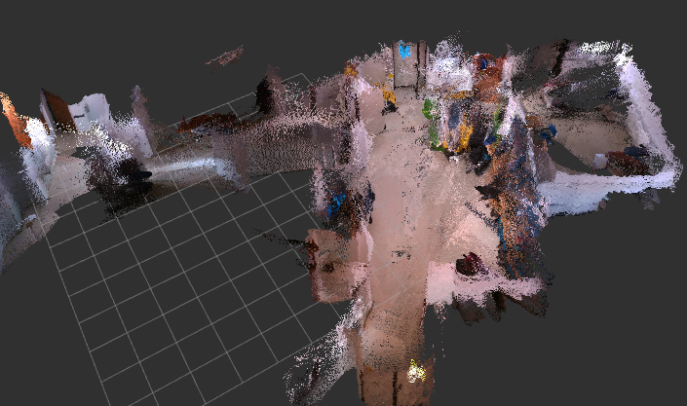
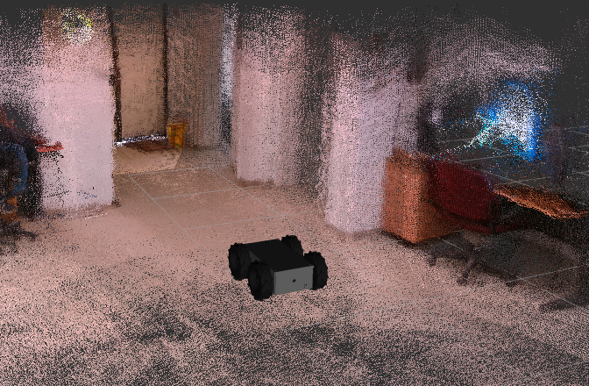
Experiments
Virtual Model
using RealSense D435
Scouting robotic platform
ROS + RVIZ
SLAM + autonomous navigation algorithms
Notes:
In ARL, robotic platform have been developed to scout in the greenhouse, carrying robotic manipulator.
We are using ROS- Robotics Operation System, and Rviz, for visualization, to develop the SLAM algorithm as well as autonomous real time navigation algorithms testing two depth cameras:
Kinect – TOF Camera
Intel Real Sense D435i – Stereo depth camera
A Virtual Model of our lab created using the real sense camera

Slide 7
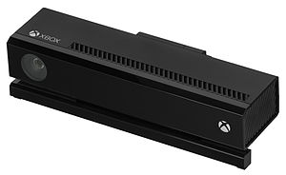
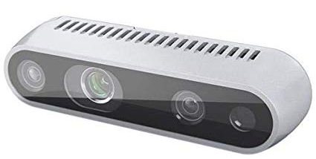
Tested 2 types of Depth Cameras
Experiments
Kinect V2 – TOF camera:
- Very clear and smooth image
- Sensitive to light
- Must use encoders
RealSense D435i – stereo camera:
- Good image
- Build in IMU: Improved SLAM
Notes:
From the mapping experiments we Tested 2 types of depth sensors:
- The Kinect gives a very clear and smooth image .
Because the Kinect uses TOF technology, it is very sensitive to light. Because of this it must be used with encoders which improve his SLAM but not enough.
- The real sense camera gives a good image but not as smooth as the Kinect, it comes with a built in IMU which improves the SLAM.

Slide 8
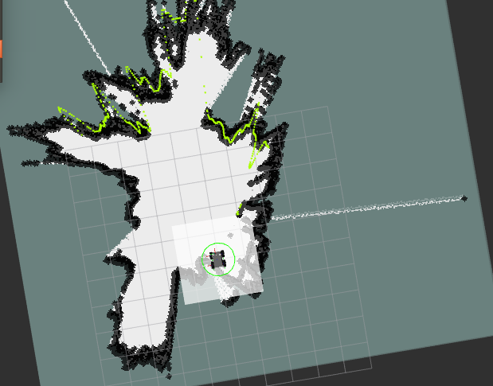
Experiments
Autonomous Navigation
2D Map with obstacles and free space
using RealSense
D435
Notes:
in order to navigate autonomously, the algorithm creates, using depth cameras, 2D map with obstacles and free space where it can drive through.

Slide 9
Experiments
Mapping - Greenhouse
Creating 3D Virtual Model of Greenhouse
using Kinect
Notes:
Here can be seen a video of mapping the greenhouse and the 3D Virtual Model that was created using the Kinect.

Slide 10
Experiments
Mapping – Greenhouse (cnt’d)
3D Virtual Model of Greenhouse using Kinect
Discover anomalies by comparing 3D Virtual Models
Notes:
presented here a video of the 3D Virtual Model, which you can actually go between the crops rows.
The 3D Virtual Model can also be used in order to discover anomalies in the yield, by comparing 3D Virtual Model from different times.

Slide 11
Experiments
Collaborative control
Type | Control \ Communicate | Effectiveness | Requirements
Storage Sharing (Dropbox) | Communicate | - | Install 3rd party software
Screen Sharing (TeamViewer) | Take over Control | + | Install 3rd party software
SSH (Secure Shell) | Communicate | ++ | Configurations
Notes:
–for information sharing and dynamic decision-making we tested several types of communication between the remoted centers (ARO &UMD &PU).
- For the First type of communication we examined Dropbox. The mobile platform snapped an image, uploaded it to dropbox and Purdue downloaded it. Then, Purdue uploaded to dropbox a set of commands to move the mobile platform.
-Another method that been tried is communicate via SSH.
SSH allows us to communicate between the research centers in real time, share all the data from ROS and there is no one center which controls the operation , all the centers are communicate between themselves.

Slide 12
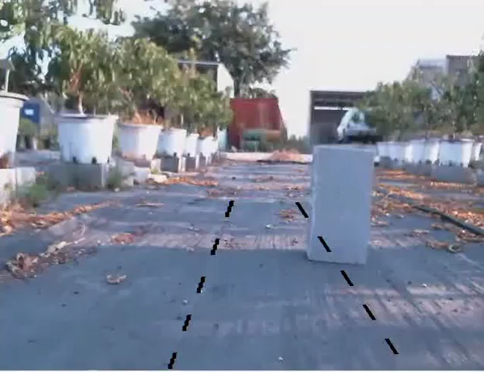
Experiments
Collaborative control (cnt’d)
Israel View
Purdue View
Take over by TeamViewer :Gives motor commands with PC keyboard
Operator in Indiana and Robot in Israel (~10000 km)
Notes:
-We also tried to remote control via Screen sharing (TeamViewer): the remote operator takes control over the robot and can see all its data.
- presented here a video of the robotic platform in Volcani (Israel) controlled remotely from Purdue university, USA, about 10,000 km away via TeamViewer. The operator in Purdue can control the movement of the platform with his PC keyboard and see the 3D virtual model that created with the depth sensors.
-the black lines represented the wheels direction

Slide 13
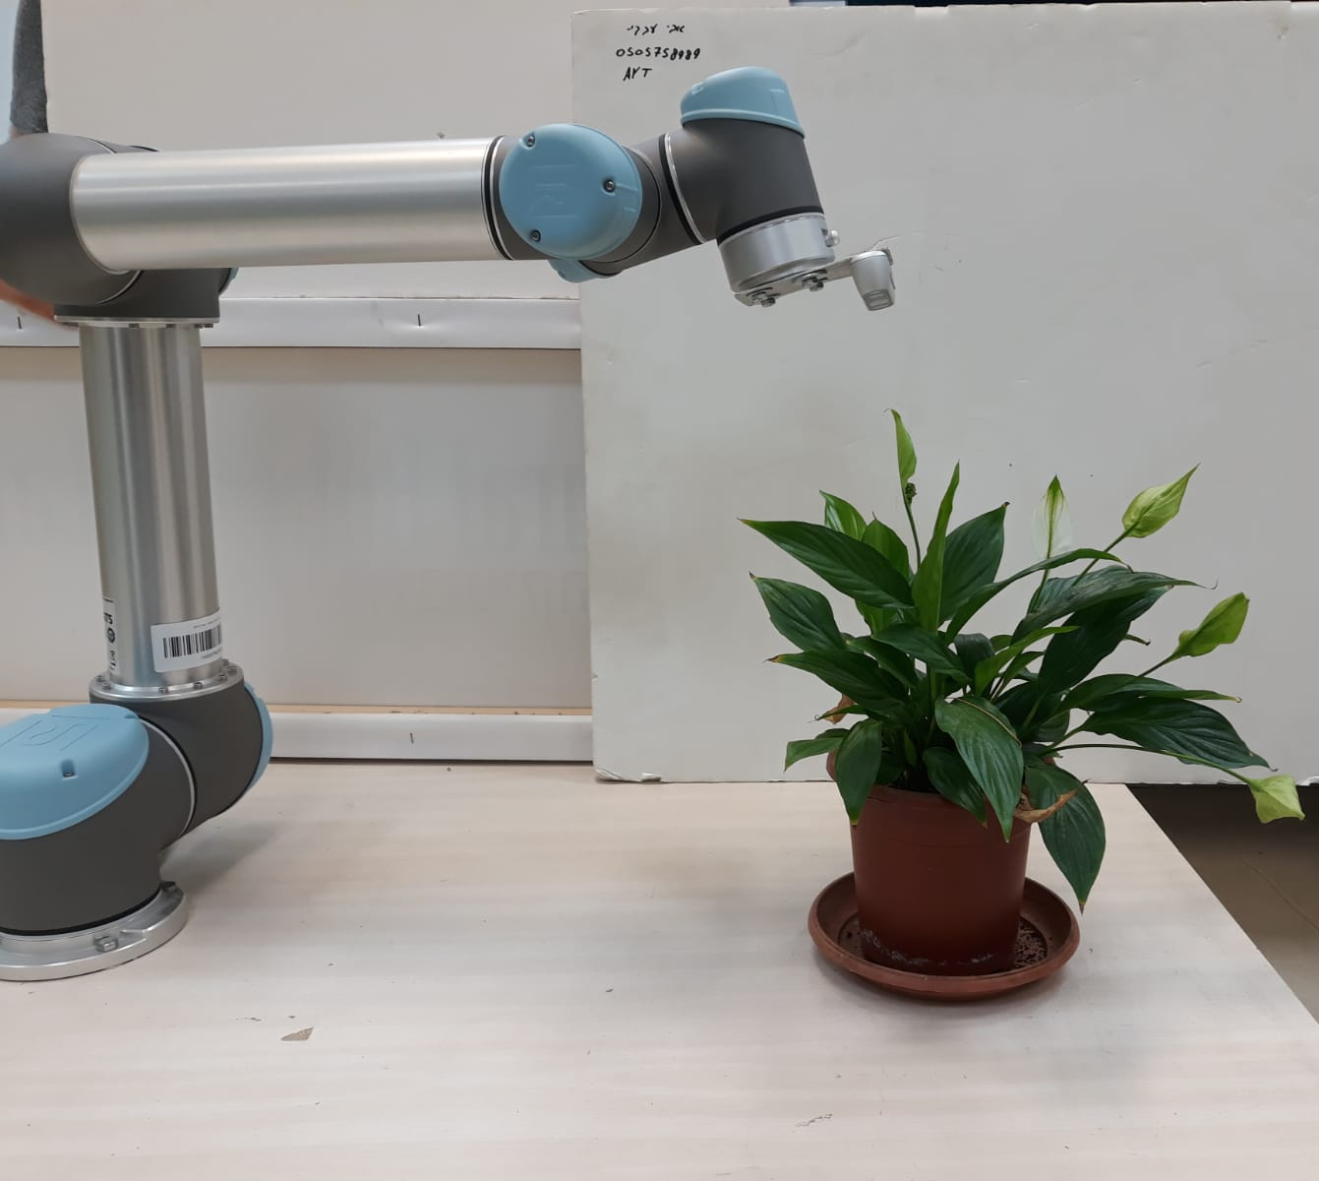
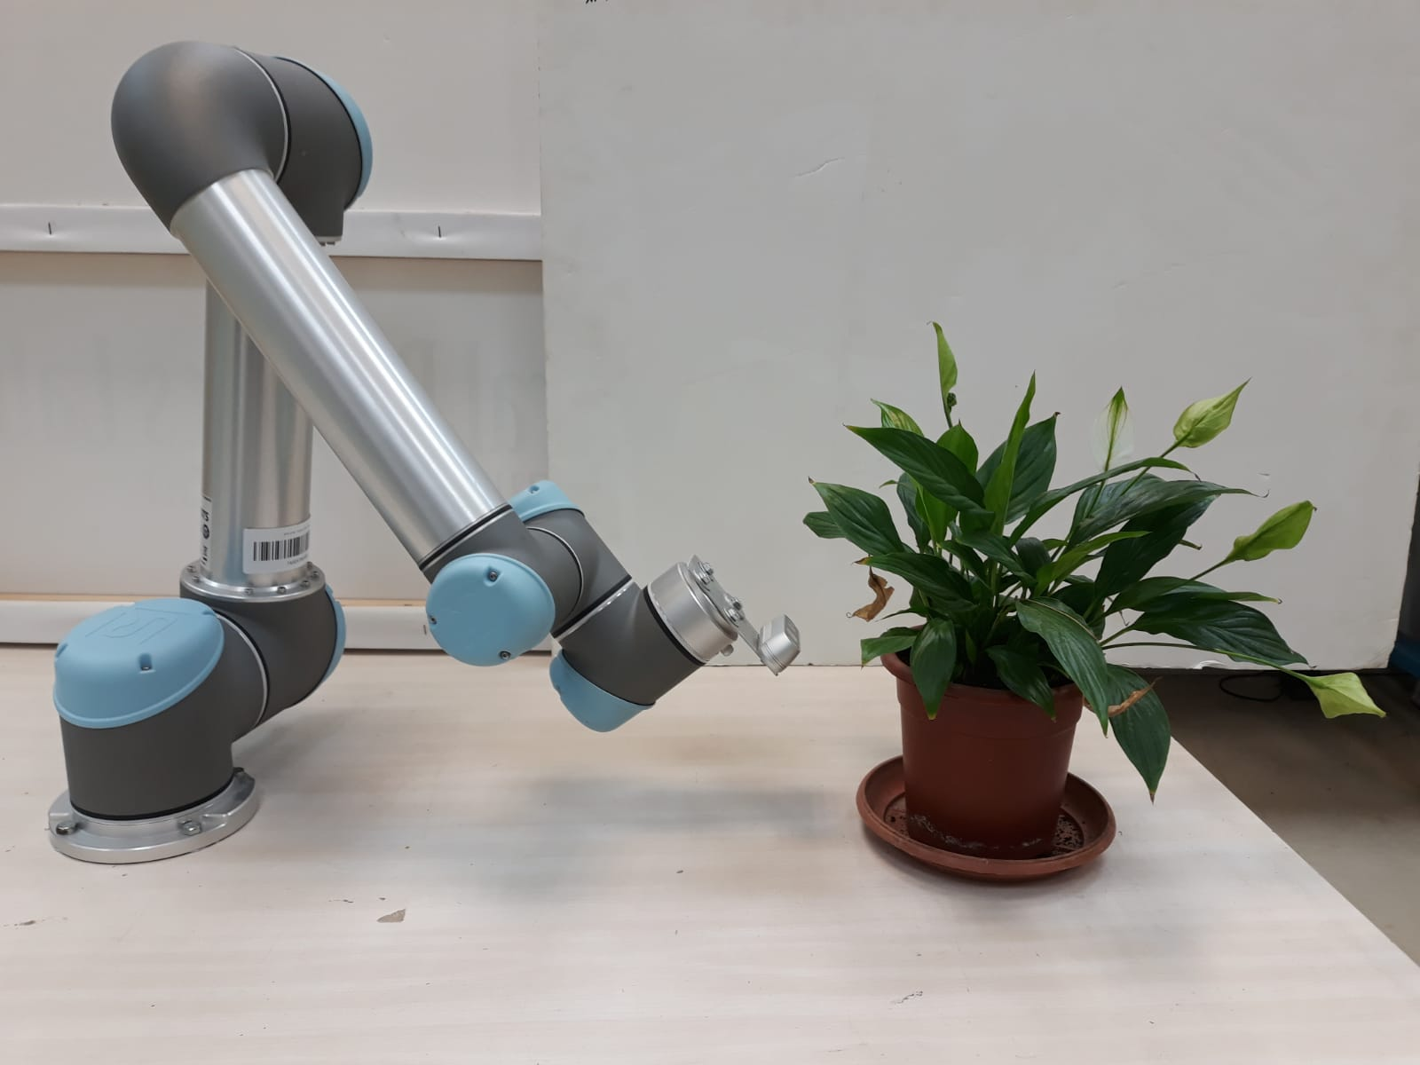
Manipulator
Carrying sensing system
Scan for disease from top
Scan for disease from bottom
Notes:
In order to detect the stresses on the plants we are going to mount a manipulator arm on the platform, which will carry the sensing system.
The manipulator is required because the symptoms of each disease are appearing in different locations, in some diseases in the upper part of the canopy and other in the lower part.
For now we are using UR5 manipulator, but part of the research and my master thesis research question is to find the optimal arm to this task.

Slide 14
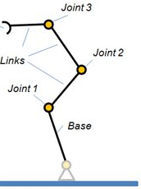
Manipulator Optimization
Objectives:
Min. Degrees of Freedom
Min. Cycle Time
Number Points of Detection : 5
Independent variables :
Number Degrees of Freedom: 3-6
Joints Types: Prismatic(P), Rotational(R)
Joints sequences: e.g. R-R-P, R-R-R, R-P-P
Links Lengths: 0.1 ,0.4, 0.7 (meters)
Number of combinations : 2,238,974,784
Notes:
In order to find the optimal manipulator I am using ROS and Gazebo as simulator.
The Objectives of the optimization is to find the manipulator, with min. DOF and min cycle time, that can reach to all desired detection points.
The independent variables: DOF, Joints Types, joints sequence and links lengths.
- This gives me over 2 billion combinations, so some assumptions must be done:

Slide 15
Manipulator Optimization (cnt’d)
Assumptions:
First joint is rotational along Z axe
First link length = 0.1m
Total length of all the links > 1m
2 adjacent prismatic joints must be perpendiculars
No more than 3 prismatic joints
Notes:
-
-
-

Slide 16
Manipulator Optimization (cnt’d)
After the assumptions the number of combination dropped:
2,238,974,784→ 52,288,787 2 Order of magnitude
Average simulation time per combination: 8.5 seconds → over 14 years
Develop optimization method that calculate in reasonable time
Simulation of manipulator arm
All Links are cylindrical
6 DOF
R-R-R-R-R-R
5 sampling points
Plant – cylindrical shape
Notes:
-
-
-
After all these assumptions, even the number of combination dropped in 2 order of magnitude, we still have more than 52 million combinations, with avg time per combination of 8.5 seconds, which takes more than 14 years of simulation.
Its not realistic to develop a method that will check all the combinations, therefore optimization method that calculate in reasonable time will be developed.
presented here a simulation of a manipulator which reaches to the desired points.
In order to simplify the simulation the plant represented as a cylinder.
All the links of the manipulator have also had a cylindrical shape.
The manipulator in the video had six DOF and all its joints are rotational .

Slide 17

Thank You For Listening
Acknowledgement: BARD grant IS-4886-16R
Tamir Mhabary
tamirm@volcani.agri.gov.il
Notes:
The autonomous navigation algorithm is based on DWA – Dynamic Window Approach
I would like to thank BARD for funding the project

